Slide 1
Final Project Report
Stereovision
Object Detection
Action Tracking

Slide 2
Objectives
A lightweight software to track people and objects with live camera feed(s).
Goal is to optimize such that it should be able to run on edge devices.
Classical image processing techniques must be used to improve performance and in methodology used.
Surveillance objectives such as identification, tracking, monitoring and logging movements of people in one and two camera systems.
Performance objectives such as frame skipping, thresholding, tagging bounding boxes, etc. must be explored

Slide 3
Deliverables
Gaze Detection
Face Detection
Pose Detection
Relative Velocity
Person Re Identification ( 2 Camera )
Depth Perception ( 2 Camera )
Face recognition
Face re identification

Slide 4
Phase 1
1 Camera Systems

Slide 5
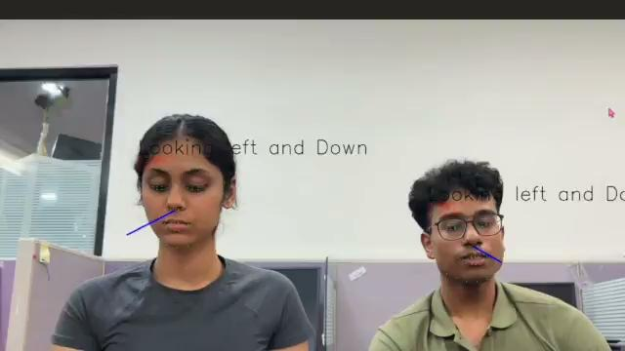
Demo - Gaze Detection

Slide 6
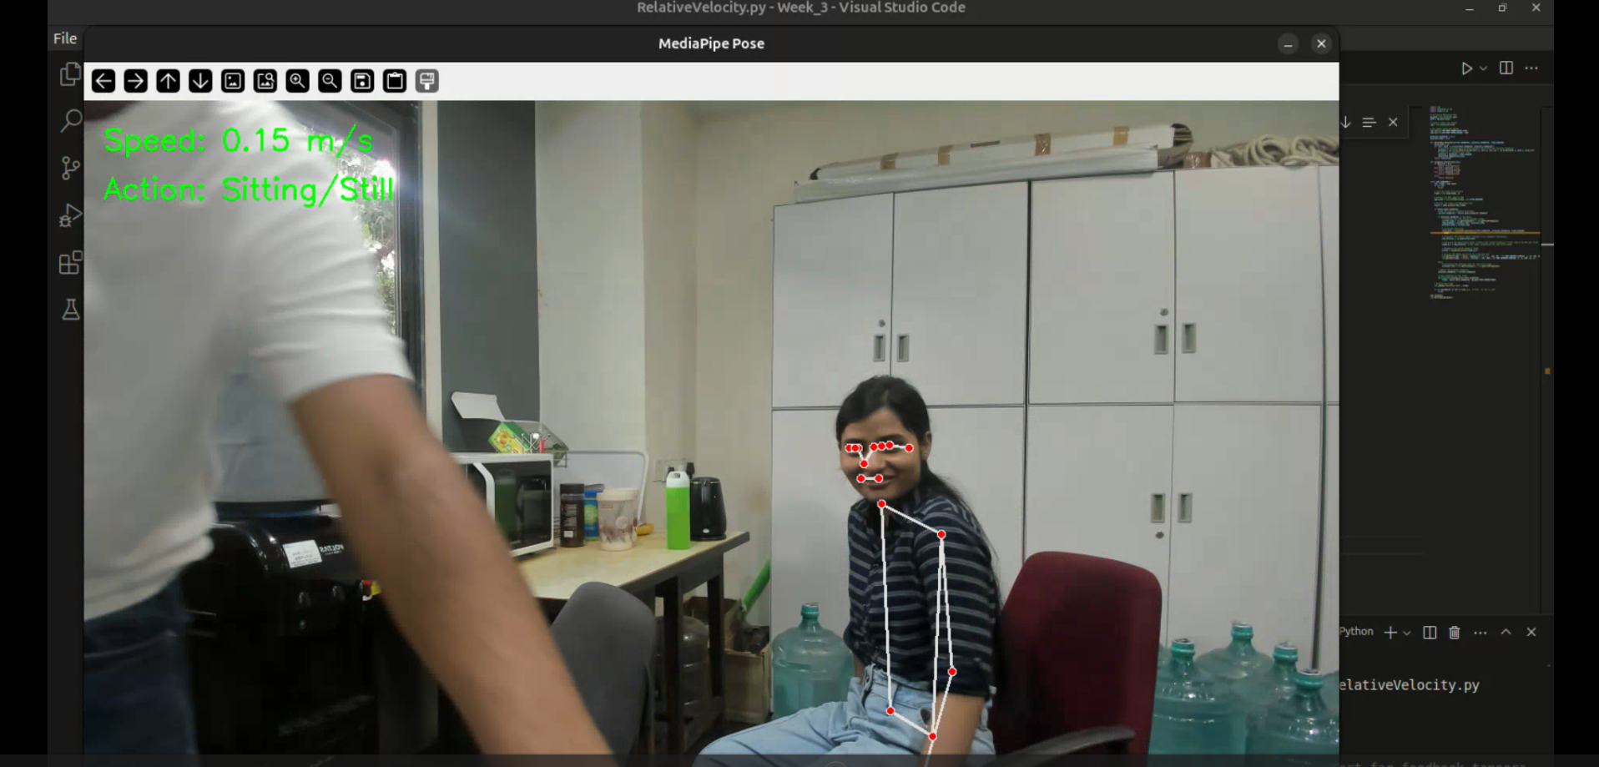
Demo - Relative Velocity

Slide 7
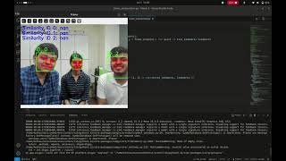
Demo - Face Detection

Slide 8
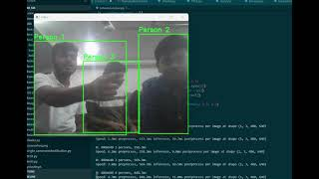
Person identification: Torso

Slide 9
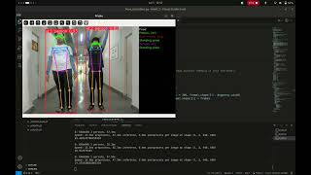
Demo - Pose Detection

Slide 10
Phase 2
2 Camera Systems
[ StereoVision]

Slide 11
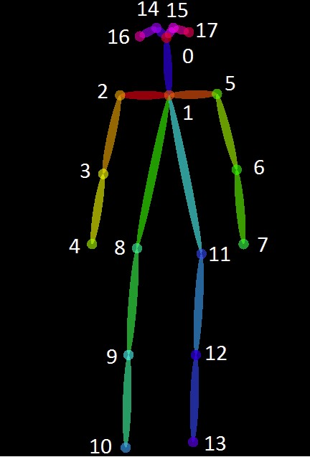
Demo - Person Re Identification
1 Joint Set has:
17 Key Points
17 RGB Tuples
1 Bounding Box
1 Frame has:
Multiple Joint Sets
1 Camera Feed has:
A series of Frames
The RGB Matrix:
Map the Sum of the Euclidean Distance between each common keypoint between two joint sets of two separate frames.
Fig. Key Points of a Joint Set

Slide 12
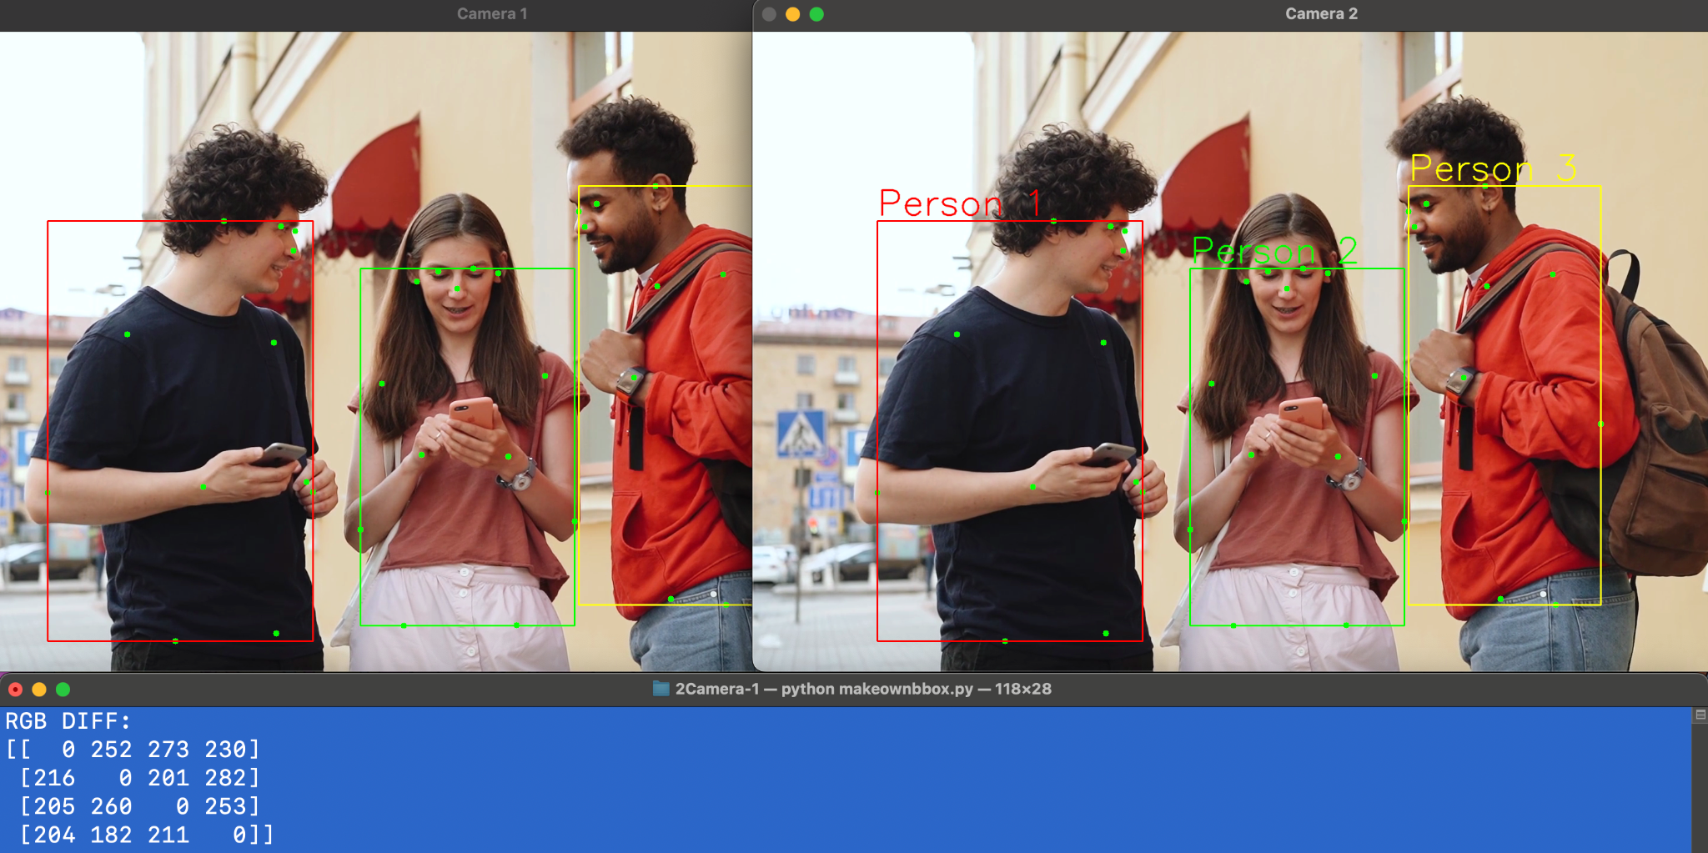
Gives us the two persons with the least RGB difference. Thresholding eliminates least worst option issue.

Slide 13
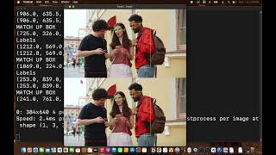

Slide 14
Face - Recognition and Identification
Real-Time Face Recognition and Identification with Individual ID
Main Goals:
Identify the face using joint sets, key points, RGB matrix and bounding box on live camera feed
Optimize frame processing while maintaining high accuracy in face detection and recognition.
Running the face-recognition on multiple cameras

Slide 15
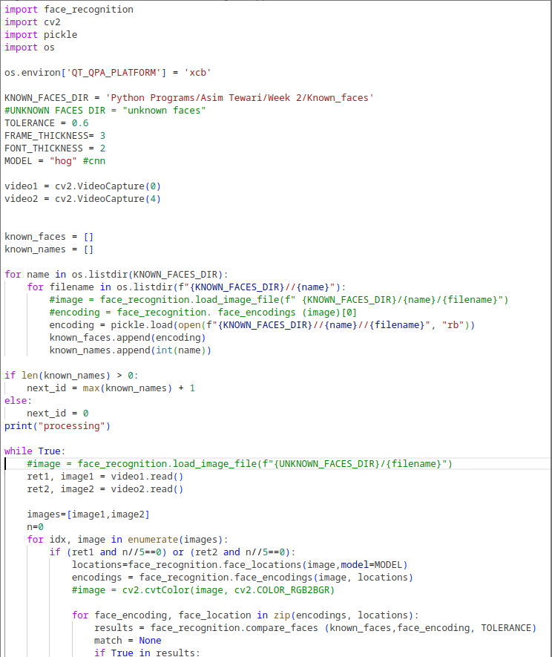
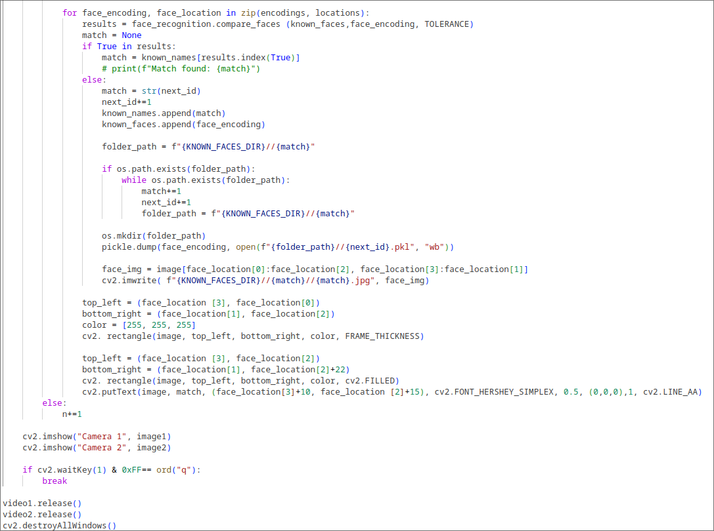
Face- Recognition and Identification
Real-Time Face Recognition and Identification with individual ID
Full Code:

Slide 16
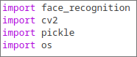

Face- Recognition and Identification
Real-Time Face Recognition and Identification with individual ID
Highlights of Code:
Libraries
This saves the encoding of the face append that encoding into known_face variable

Slide 17
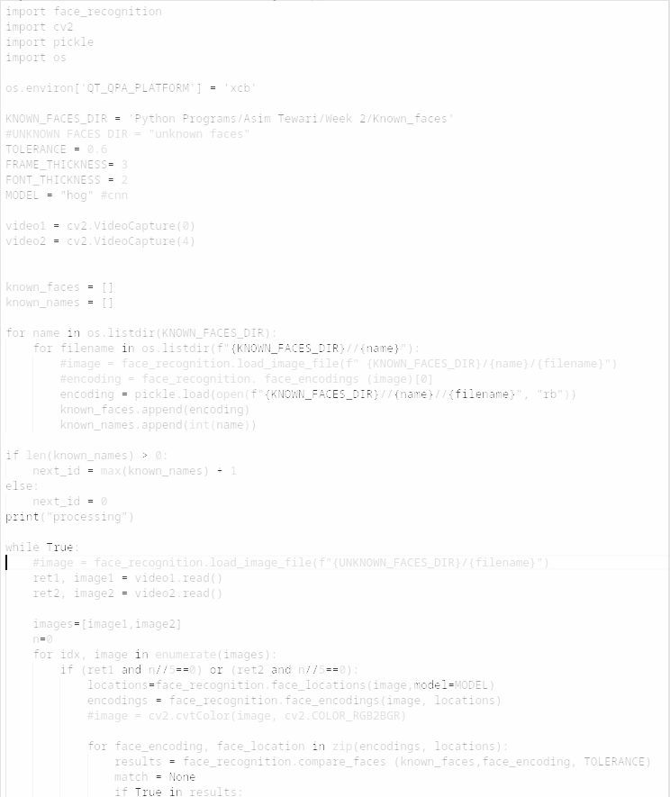
Face- Recognition and Identification
Real-Time Face Recognition and Identification with individual ID
Highlights of Code:
This part of code runs a loop and find whether there is know face or not.
If not then it save the face at this location

Slide 18
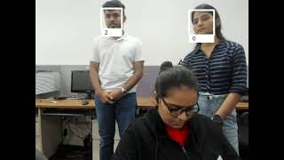
Face- Recognition and Identification
Real-Time Face Recognition and Identification with individual ID
Output:

Slide 19
Face Tracking
Tracking of face once it is identified
Goal
Once face is identified we should track that face without putting it in the model
To decrease the computation power in face recognition
To use less memory to store the data of faces

Slide 20
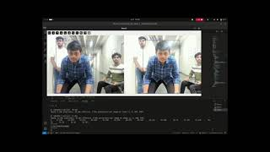
Demo - Depth Perception Using Re Identification [Parallel Identical Cameras]

Slide 21
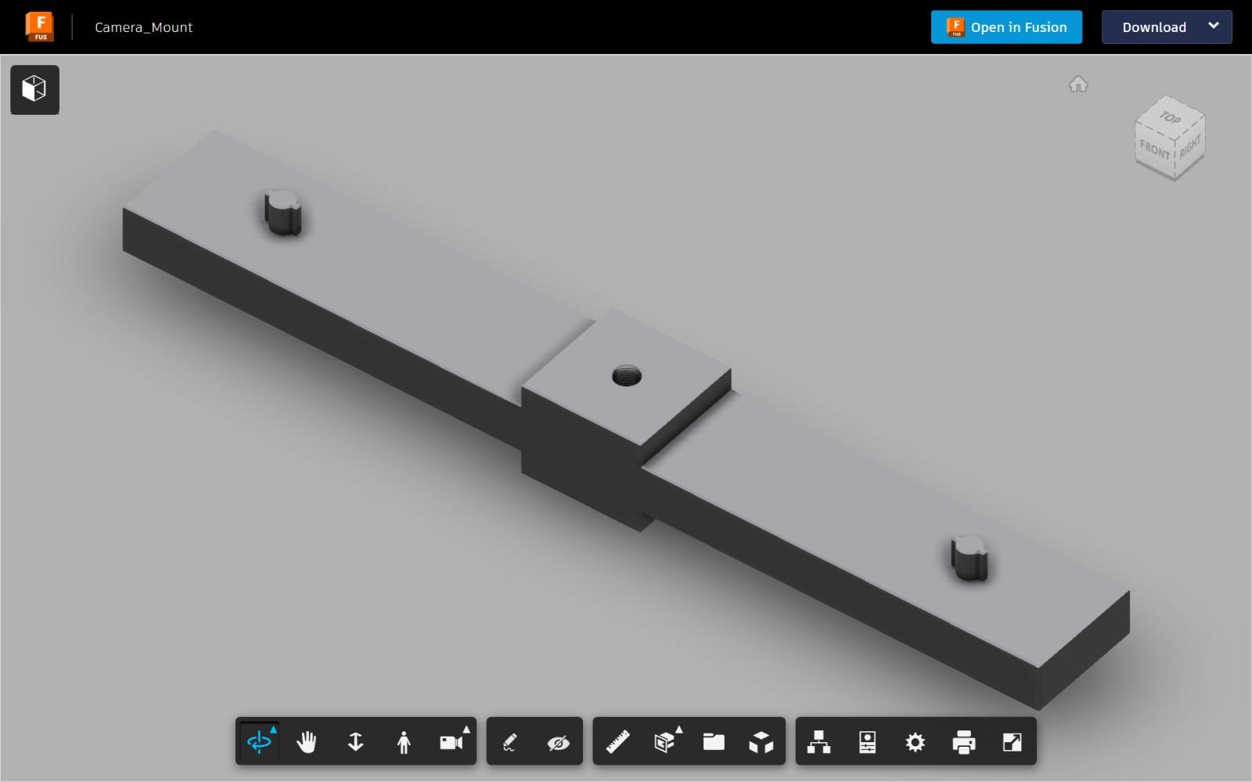
3D Printed Camera Rig Model

Slide 22
Future Scope
Action Detection
Object Association
Logging Real Time Data
Depth Perception Using Re Identification [NonParallel NonIdentical Cameras]
Merging all modules into one lightweight software

